Slide 1

MINI PROJECT
Anshul Rana
Himanshu Chandra
Manish Tiwari
Calorie Burn Prediction System
Under the supervision of
Mr. Anuj Kumar Dixit
(Assistant Professor)
Department of Computer Science & Engineering
Graphic Era Hill University, Haldwani Campus

Slide 2

TABLE OF CONTENT
ABSTRACT
INTRODUCTION
METHODOLOGY
LIBRARIES AND TECHNOLOGY USED
CONCLUSION
SURVEY AND STUDIES

Slide 3
ABSTRACT
Calorie burnt prediction by machine learning algorithm” aim to predict the number of calories burnt by an individual during physical activity using machine learning techniques. We collected a dataset that includes features such as heart rate, body temperature, and duration of activity. We used various machine learning models, including XGBoost, linear regression, SVR and random forest, to predict calorie burn based on 15,000 data samples.
Notes:
Data is collected from various factors such as age, weight, height, heart rate, body temperature, and duration of activity.

Slide 4

INTRODUCTION
A calorie is usually a measure of heat energy
The formula to use is: METs x 3.5 x (your body weight in kilograms) / 200 = calories burned per minute.
Health and fitness gaining importance.
Wearable devices and fitness trackers used for monitoring physical activity.
Calorie burn tracking crucial for setting and achieving fitness goals.
Study objectives: Collect data on physical activity and calorie burn from various sources. Preprocess and clean data for accuracy. Develop machine learning models (linear regression, XGBoost, random forest) to predict calorie burn.
Notes:
Today, people have very tight schedules due to changes in their lifestyle and work commitments. But it requires regular physical activity to stay fit and healthy. People do not pay attention to their eating habits leading to obesity. Obesity is becoming a big and widespread problem in today's lifestyle. This makes people choose diets and do a lot of exercise to stay fit and healthy.
MET = Metabolic Equivalent Task
By developing an accurate calorie burn prediction model, we can help individuals make more informed decisions about their physical activity and improve their overall health and well-being.

Slide 5

Objective of The Study
This study aims to propose a solution for predicting calories burned using machine learning algorithms. The learning algorithms considered are Linear Regression, System Vector Machine (SVR), Random Forest Regression and XG Boost Regression. The goal of this study is to evaluate which algorithms are the best in predicting calories burned by an individual based on weight, gender, age, height, duration of the activity, heart rate, and body temperature.

Slide 6
LIBRARIES USED
Streamlit:
Streamlit is a free and open-source python framework. We can quickly develop web apps for Machine Learning and Data Science by using Streamlit. Streamlit can easily integrates with other popular python packages such as NumPy, Pandas, Matplotlib,Seaborn. Streamlit provides fastest way to develop and deploy web apps.
Matplotlib:
Matplotlib is a popular Python packages used for data visualization. It is a cross-platform library for making plots from data in arrays. It helps in creating static, animated and interactive visualizations in python.
Seaborn:
Seaborn is the data visualization library. It is a superset of Matplotlib which provides additional features and Seaborn provides exploration and better understanding of data. Seaborn closely integrates into the data structures from python
Pandas:
Pandasis a software library written for the Python programming language for data manipulation and analysis. In particular, it offers data structures and operations for manipulating numerical tables and time series.
It has functions for analyzing, cleaning, exploring, and manipulating data.
Numpy:
The NumPy library contains multidimensional array and matrix data structures. It provides ndarray, a homogeneous n-dimensional array object, with methods to efficiently operate on it. NumPy can be used to perform a wide variety of mathematical operations on arrays.

Slide 7
METHODOLOGY
This study aims to predict the calorie burn during physical activity using machine learning models.
Use data set to train our machine learning models.
Pre-processing of records is necessary before performing the operation that provides statistics.
After that, the data processing is complete and the data is organized into diagrams and graphs using a number of visualization techniques.
Here, we use the XGBoost, SVR, Linear Regression and Random Forest regressor as the ML (machine learning) model to compare and then evaluate these models.
Notes:
Data preprocessing in Machine Learning refers to the technique of preparing (cleaning and organizing) the raw data to make it suitable for a building and training Machine Learning models.
Extreme Gradient Boosting (XGBoost) is an open-source library that provides an efficient and effective implementation of the gradient boosting algorithm.

Slide 8
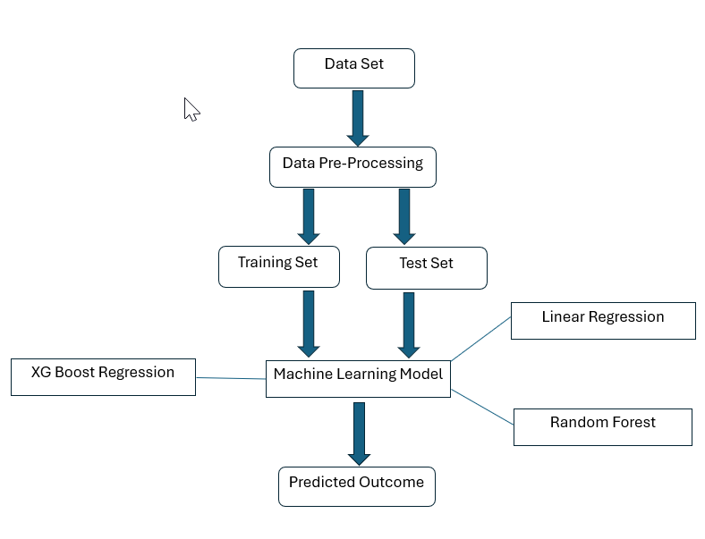
Workflow Of Our Project
Notes:
Data collection-dataset collection is the primary step. we used Kaggle as the data repository. The data used here is both categorical and numerical.
2. Pre-processing of data- it is important that we process our data before passing it to the model for better results. null values and missing values are handled at this point because the information on our data directly affects how our model learns.
3. Analysis of data- firstly the two CSV files(“exercise.csv”, and “ calories.csv”) from Kaggle are uploaded to our used platform collab. Data visualization is carried out using various charts and graphs. the two types of correlation positive and negative are studied between various features. The data is then split into test and training data. the used regression models are loaded. test data is used to assess the prediction.
4. Machine learning model- all the chosen algorithms are applied at this stage to determine the r^2 value and absolute mean error value. Among the various algorithms, the best results are shown by XGBoost regression which gives the least absolute error value of 1.48 and efficient way to predict calories burnt.
5. Evaluation – the results of different algorithms are compared and the best among them is used to calculate the prediction of calories burnt during exercise along with various other factors such as age, gender height, weight, body temperature, and heart rate.

Slide 9
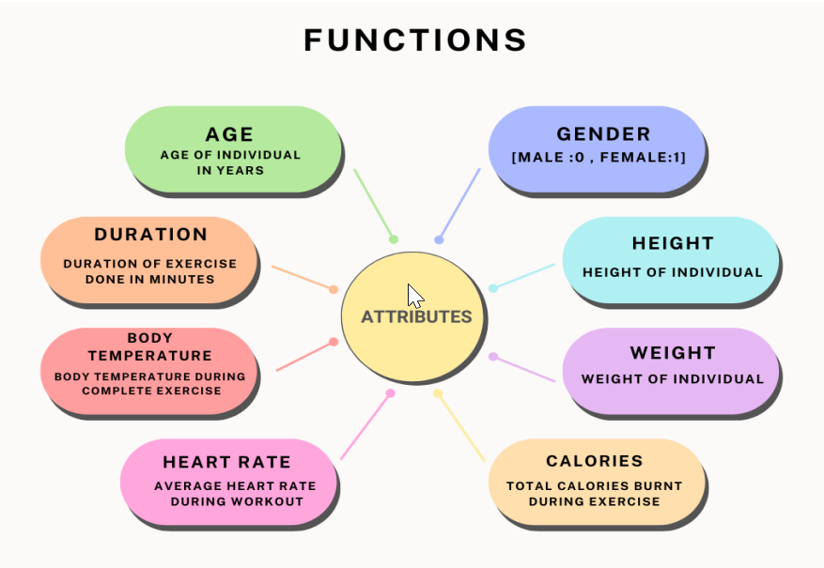
DATA SOURCE
We have used the “Kaggle” Repository as our dataset store. We used two CSV files which hold 15000 instances for 7 attributes. The attributes range from Gender, Age, height, weight, Body temperature during exercise, Heart rate, and duration of workout in the “exercise.csv” file which is used as training data, ”calories.csv” contains the corresponding values of calories burnt by individuals of the exercise data set.

Slide 10

Literature Review
Sathiya T et al. : Applied a CNN model to classify food items from input images and predict user’s calorie intake. They used deep learning and image processing techniques, achieving 91.65% accuracy.
Sona P Vinoy et al.: Used machine learning algorithms such as XGBboost 9 and linear regression models to predict calorie burn during workouts. Their dataset included 15,000 entries with attributes like age, height, weight, duration, heart rate, body temperature, and calorie count. The mean absolute error was 2.71 for XGBboost and 8.31 for linear regression but model accuracy was not mentioned.
Suvarna Shreyas Ratnakar et al. : Used the XGBboost machine learning algorithm on a dataset of 15,000 entries to predict calories burnt from physical activities. The mean absolute error was 2.7, but model accuracy was not mentioned.
Rachit Kumar Singh et al. : Used logistic regression, linear regression, and lasso regression models to predict calorie burn. Details on mean absolute error, dataset size, and model accuracy were not provided.
Mohammad Tarek Aziz, Sudheesh R, Renzon Daniel Cosme Pecho, Nayeem Uddin Ahmed Khan, Akba Ull Hasna Era, MD. Abir Chowdhury. [11]: Used Machine Learning Algorithms such asXGBoost, SVM, Linear Regression and Random Forest Regression to predict Calories burnt with an accuracy of 99.67% and MAE of 1.48.

Slide 11
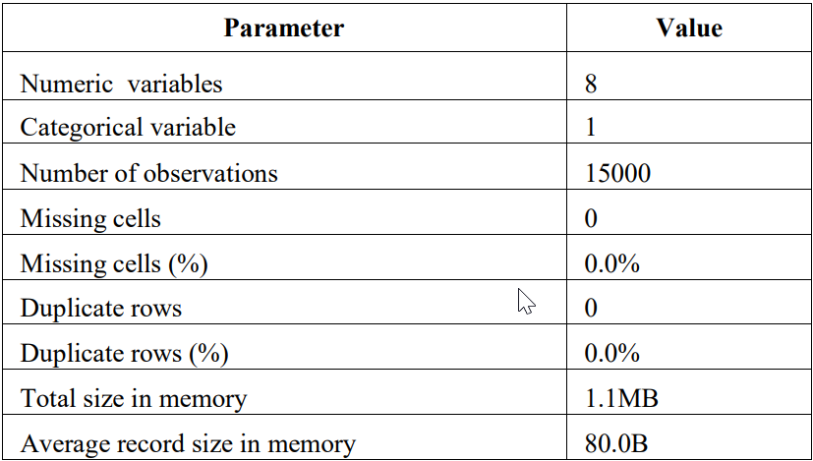
DATA PRE-PROCESSING
TABLE 1 : DATASET SPECIFICATIONS
Pre-processing of data- it is important that we process our data before passing it to the model for better results. null values and missing values are handled at this point because the information on our data directly affects how our model learns.
Notes:
The data that was used in this study was taken from the Kaggle website. Table I shows the dataset specification that contains 15000 observations and nine variables. The Raw data gathered has eight (8) numeric variables and one (1) categorical variable. The data has no duplicate rows and no missing cells.
Except Gender variable all are Numerical variables

Slide 12
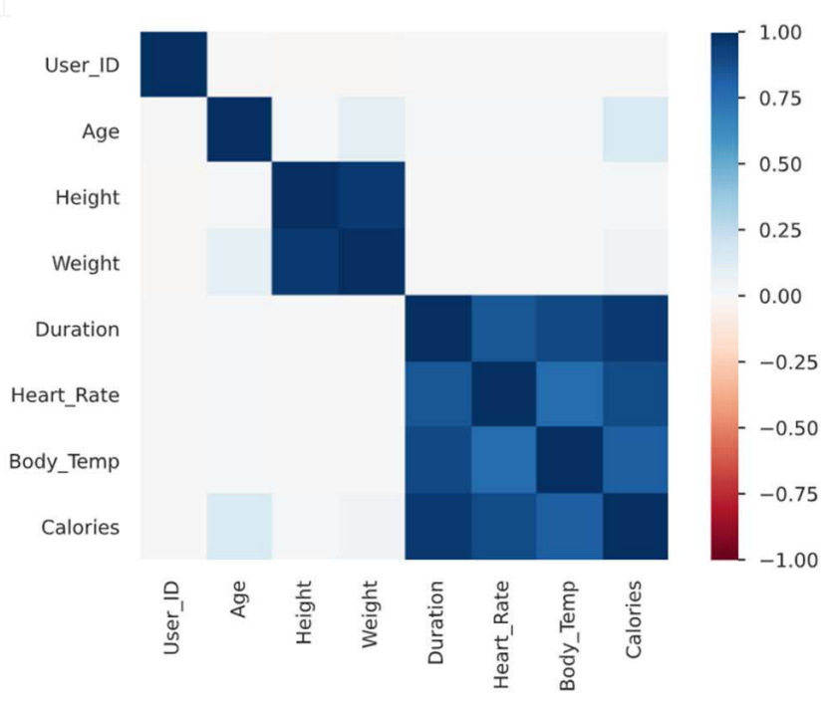
DATA ANALYSIS
The variables in the dataset must be analyzed first in order to determine their relationship to the target variable, which is the calorie burned.
The variables heart rate, duration of exercise, body temperature is highly correlated with the dependent variable calorie, followed by the height and weight.
Fig : Pearson’s Correlation between Variables
Notes:
Pearson’s correlation is a statistical measure that evaluates the strength and direction of the linear relationship between two continuous variables. It is a widely used method to measure the correlation between two variables, and it is denoted by the symbol “r”
The Pearson correlation coefficient can be interpreted as follows:
A value of 1 indicates a perfect positive correlation, meaning that as one variable increases, the other variable also increases.
A value of -1 indicates a perfect negative correlation, meaning that as one variable increases, the other variable decreases.
A value of 0 indicates no correlation, meaning that there is no linear relationship between the two variables.
A value between 0 and 1 indicates a positive correlation, meaning that there is a linear relationship between the two variables, but it is not perfect.
A value between -1 and 0 indicates a negative correlation, meaning that there is a linear relationship between the two variables, but it is not perfect.

Slide 13
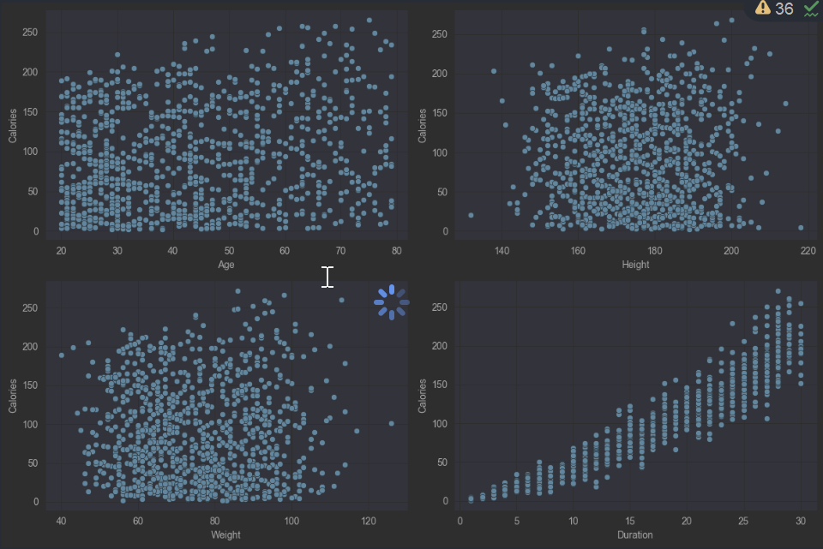
# Graphs for numerical and categorical data
Notes:
As expected higher is the duration of the workout higher will be the calories burnt. But except for that, we cannot observe any such relation between calories burnt and height or weight features. Here we can observe some real-life observations: 1. The average height of the boys is higher than girls. 2. Also, the weight of the girls is lower than that of the boys. 3. For the same average duration of workout calories burnt by men is higher than that of women

Slide 14
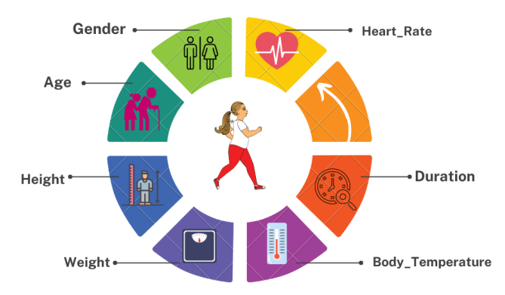
Feature Selection
Notes:
based on the above visual analysis of data :
Certain variables or we can say factors are used which affects our calorie burnt prediction in our model. These are ---

Slide 15
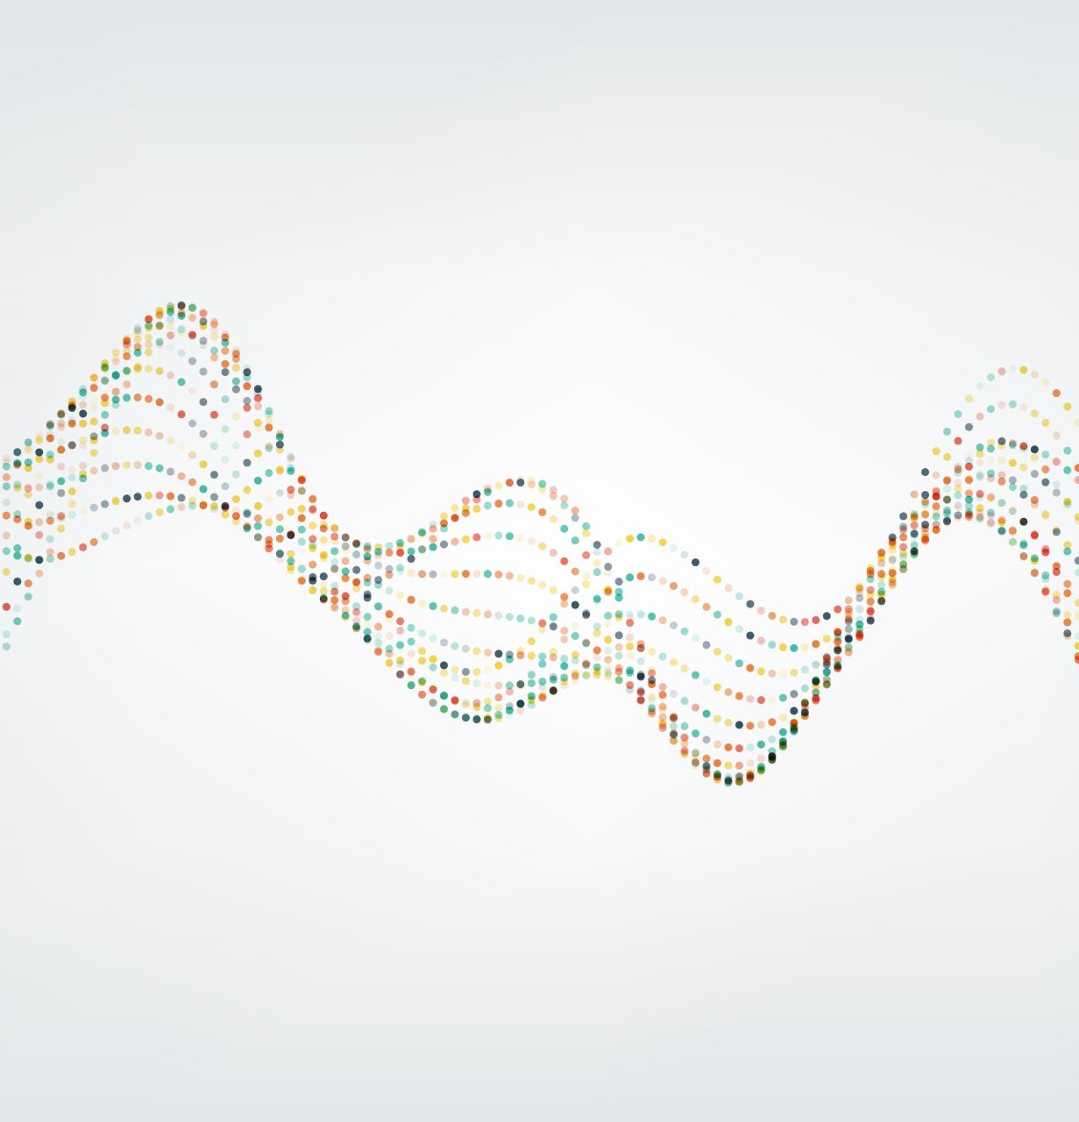
REGRESSIVE MODELS
Regression is used in predictive modeling in which algorithms are used to predict continuous outcomes based on the given inputs.
Linear regression model :- is used to identify the linear relationship of the input variables and output variables.
Random forest regression :- it is a supervised learning algorithm this model combines predictions from multiple machine learning algorithms to make a more accurate prediction than a single model.
XG boost regression :- It stands for extreme gradient boosting. This ensemble learning model produces strong predictions by combining the prediction of multiple weak models. It handles large datasets and provides efficient handling of missing values
Notes:
We have used different regressive and linear machine learning algorithms to compare and find optimal solutions.
Random Forest uses trees instead of the equation to complete the process of regression. It constructs several decision trees during training time and outputs the mean of the classes to predict all the trees

Slide 16
RESULT
Regressions | Mean Absolute Error (MAE)
Linear Regression | 8.27
Random Forest | 1.66
XG Boost Regression | 1.49
System Vector Regression (SVR) | 2.22

Slide 17
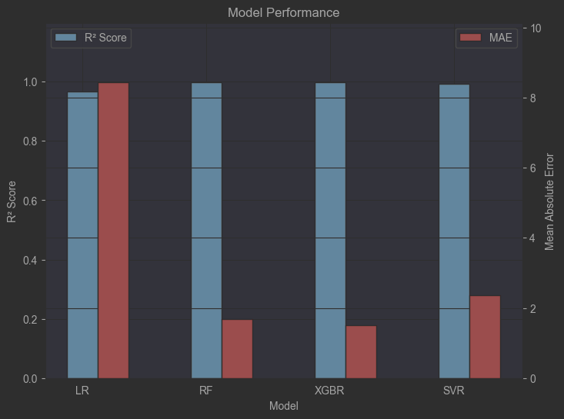
Graph of different MAE values and R^2 values
Notes:
The algorithm which provides the least mean absolute error is considered as best, this study applies various machine learning models over the dataset to find the least value of Mae, according to these results XGBoost regression is best for solving this problem with a Mae value of 1.48.

Slide 18
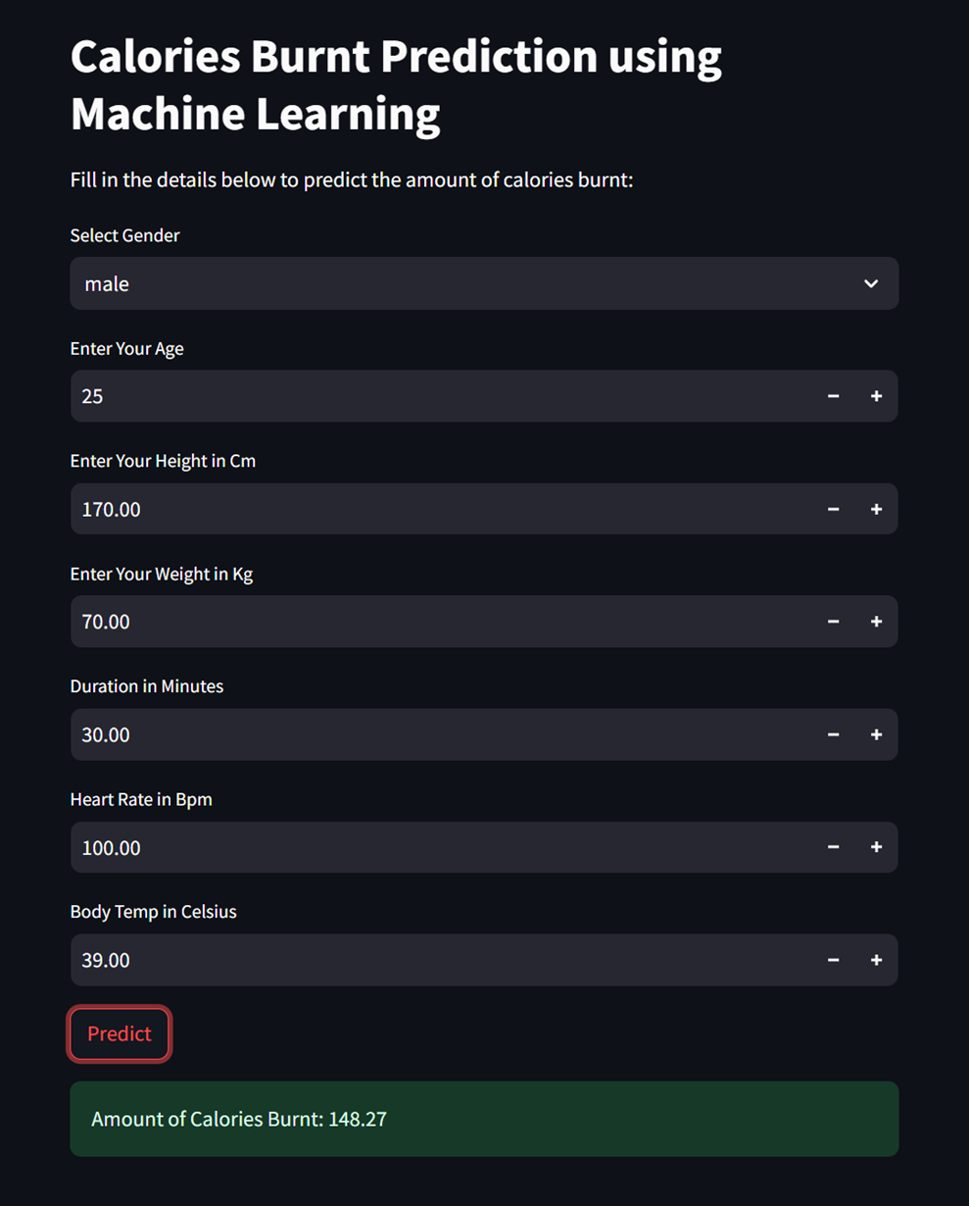
Web Model using Streamlit
Notes:
We have used streamlit library for deploying our model in web server to predict the calories burnt accurately.

Slide 19

Conclusion
This research aimed to recognize the number of calories our body burns, which depends on several factors such as age, gender, weight, height, body temperature, duration, and heart rate. It is important to understand the number of calories we eat to stay fit and healthy.
Calories burnt can be predicted from different regression algorithms such as Linear regression, XG boost regression, SVM, and Random forest regression.
Out of these regression algorithms, Extreme Gradient Boosting (XG boost) regression gives the best accurate result. The MAE(Mean Absolute Error) value of the XG boost is 1.49.
It means the errors are quite low. So, therefore, XG boost regression algorithm is the optimal algorithm for the calories burnt prediction so far.

Slide 20
THANK YOU

